Slide 1


MINI PROJECT
Chat Bot Application
SL.NO. | NAME | USN | ROLL NO.
01 | Bhakti Betageri | 02FE21BEC019 | 16
02 | Bhuvan Budavi | 02FE21BEC021 | 18
03 | Komal Melavanki | 02FE21BEC042 | 38
04 | Praveen Magadum | 02FE21BEC064 | 59
Under the Guidance of
Prof . Shweta K
Department of Electronics and Communication Engineering,
KLE Technological University’s Dr. M. S. Sheshgiri College of Engineering and Technology, Belagavi

Slide 2
CONTENTS :
SI. NO | CONTENTS
1 | Problem Statement
2 | Introduction(NLP,Chatbot)
3 | Block Diagram
4 | Real time applications
5 | Dataset
6 | Budget
7 | Output

Slide 3
Problem Statement
Design a chatbot that trains on a predefined data set stored in Json file and responds to all the questions asked by the user using Natural Language Processing Algorithm.
Dept. of ECE

Slide 4

Introduction :
In a communication-centric world, our project revolutionizes user interaction with a smart chatbot.
Using Python's versatility, we've created an advanced conversational agent that understands natural language, responds contextually, and assists in various domains employing machine learning to continuously improve and adapt to users preferences prioritizing seamless user communication
Fueled by cutting-edge natural language processing, our Python-based chatbot handles diverse queries, provides personalized recommendations, and engages users in dynamic conversations.

Slide 5
NLP
Natural Language Processing (NLP) is an AI field focused on computer interaction with human language.
Involves tokenization, part-of-speech tagging, named entity recognition, and sentiment analysis.
Faces challenges like ambiguity, context understanding, and capturing nuances such as sarcasm.
Used in machine translation, chatbots, text summarization, and speech recognition.
Deep learning techniques, including BERT and GPT models, have significantly improved NLP tasks.
NLP is a dynamic field with ongoing research, continually advancing models, techniques, and applications.

Slide 6
Literature Survey
Sl No. | Paper Title | Methods/Techniques/Algorithm used | Limitations /Disadvantages/Remarks
1 | Chatbot: An automated conversation system for the educational domain (2015) | Sophisticated natural language processing approach | No Approach towards changing of responses
2 | Retrieval-Polished Response Generation for Chatbot (2017) | AI Driven chatbot with Machine Learning and Natural Language Processing | No Approach towards changing of responses
3 | A Data Science Chatbot | Natural Language Processing and Deep Learning. | No Approach towards changing of responses

Slide 7

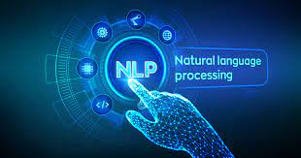

Block Diagram
Input
Output
Checking For Predefined Speech
Dept. of ECE
7

Slide 8
Detailed block diagram for project
Input text
text recognition
text analyzing using NLP
searching for predefined words in json file
Display the output text
if found return the value associated with the predefined text

Slide 9
Real Time Applications
Symptom Checker:
Enables users to input symptoms and receive information about potential health conditions, providing initial guidance on their health concerns.
Appointment Scheduling:
Facilitates convenient scheduling of healthcare appointments, streamlining the process for users to access medical services.
Medication Reminders:
Sends timely reminders to users for medication adherence, helping improve treatment compliance and health outcomes.
Health Information and Education:
Provides users with accurate and reliable information about medical conditions, treatments, and preventive measures, promoting health literacy.

Slide 10
Dataset
The Chatbot will respond based on the predefined user input stored in the json file.
When a new question is asked the bot searches for predefined text which is stored in the json file and responds back according to it.

Slide 11
Budget of the Project
We do not have designated budget allocated for this project as we are utilizing existing software resources. We are operating on a software-driven project.

Slide 12
Code Pre-optimization
We created a simple chatbot in Python that responds to user questions based on a dataset stored in a JSON file.
The initial version, referred to as pre-optimization, employs a straightforward linear search through the dataset to find matching questions and their corresponding answers.

Slide 13
Code Post optimization
The transformers library is employed to load the pre-trained model and tokenizer. Additionally, a response cache is maintained to improve performance for repeated queries.
This approach leverages the capabilities of a powerful language model to provide more contextually relevant and natural-sounding responses. Keep in mind that using such pre-trained models might have associated costs and API usage limitations depending on the model provider.

Slide 14
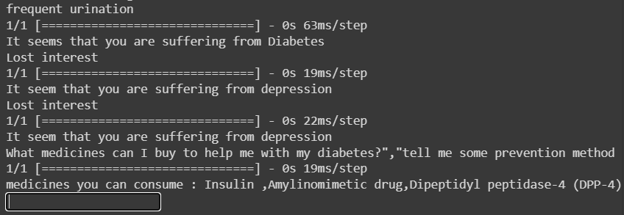
Output

Slide 15
Thank You

